Slide 1
Scrum Development

Slide 2
Agile and Scrum
To talk about Scrum development you must also touch on Agile and the Agile Manifesto. What is Agile and why does it relate to Scrum? Agile is a development method that focuses on iterative software development, as opposed to the block structure of the Waterfall model. Scrum is simply an implementation of the agile concepts in a new way.

Slide 3
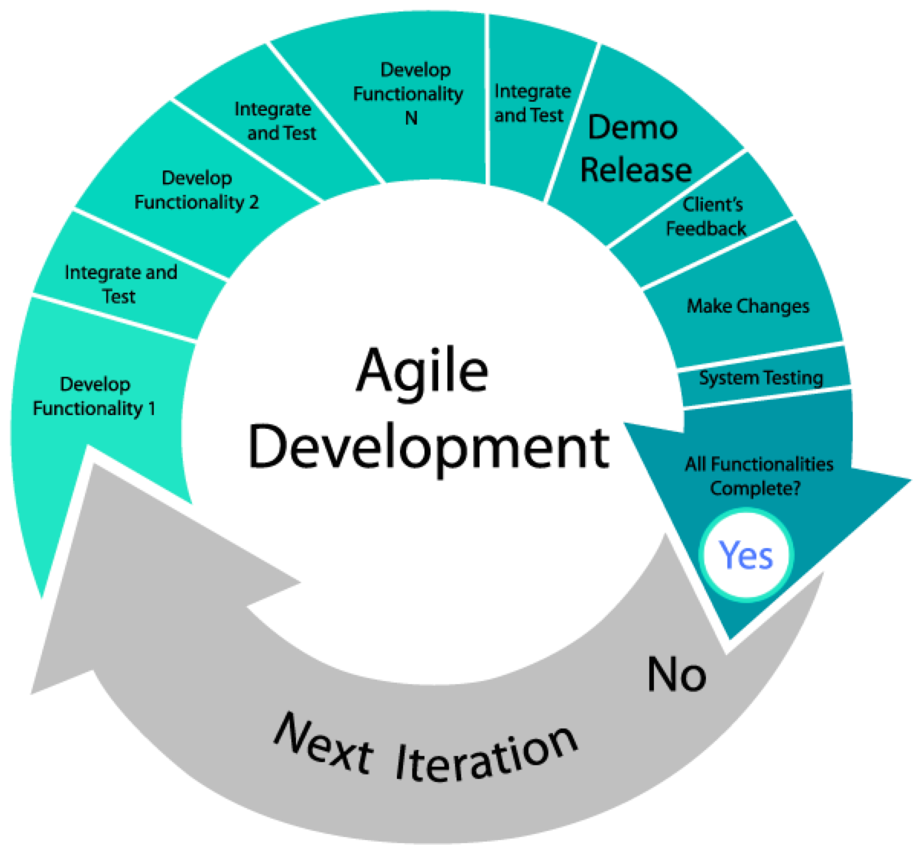

Slide 4
Agile Development Manifesto
Individuals and Interactions over processes and tools
Working Software over comprehensive documentation
Customer Collaboration over contract negotiation
Responding to Change over following a plan

Slide 5
Agile Development Manifesto Meaning
Individuals and interactions-Self-organization and motivation are important, as are interactions like co-location and pair programming.
Working software-Working software is more useful and welcome than just presenting documents to clients in meetings. It is better to comment inline with the code and to keep external documentation light, rather than heavy documents that take a lot of effort and quickly become outdated.

Slide 6
Agile Development Manifesto Meaning
Customer collaboration-Requirements cannot be fully collected at the beginning of the software development cycle, so it is better to directly involve the paying customer and their end-users, or a proxy for them so that detailed requirements can be progressively elaborated and adapted based on feedback.
Responding to change-Agile software development methods are focused on quick responses to change and continuous development.

Slide 7
The Scrum Methodology
The Scrum Team consists of a Product Owner, the Development Team, and a Scrum Master.
Scrum Teams are self-organizing and cross-functional.
Cross-functional teams have all competencies needed to accomplish the work without depending on others not part of the team.
The team model in Scrum is designed to optimize flexibility, creativity, and productivity.

Slide 8
Scrum Team Roles: Product Owner
The Product Owner should be a person with vision, authority, and availability.
Continuously communicating the vision and priorities to the development team.
Product Owner must not micro-manage.
Product Owners must be available to answer questions from the team.

Slide 9
Scrum Team Roles: Scrum Master
The Scrum Master acts as a facilitator for the Product Owner and the team.
The Scrum Master does not manage the team. The Scrum Master works to remove any impediments that are obstructing the team from achieving its sprint goals.
The Scrum Master also works to advise the Product Owner about how to maximize ROI (Return on Investment) for the team.

Slide 10
Scrum Team Roles: Team
The team is utterly self managing.
The development team is responsible for self organizing to complete work.
A Scrum development team contains about seven fully dedicated members (officially 3-9), ideally in one team room protected from outside distractions.
For software projects, a typical team includes a mix of software engineers, architects, programmers, analysts, QA experts, testers, and UI designers.
Each sprint, the team is responsible for determining how it will accomplish the work to be completed.
The team has autonomy and responsibility to meet the goals of the sprint.

Slide 11
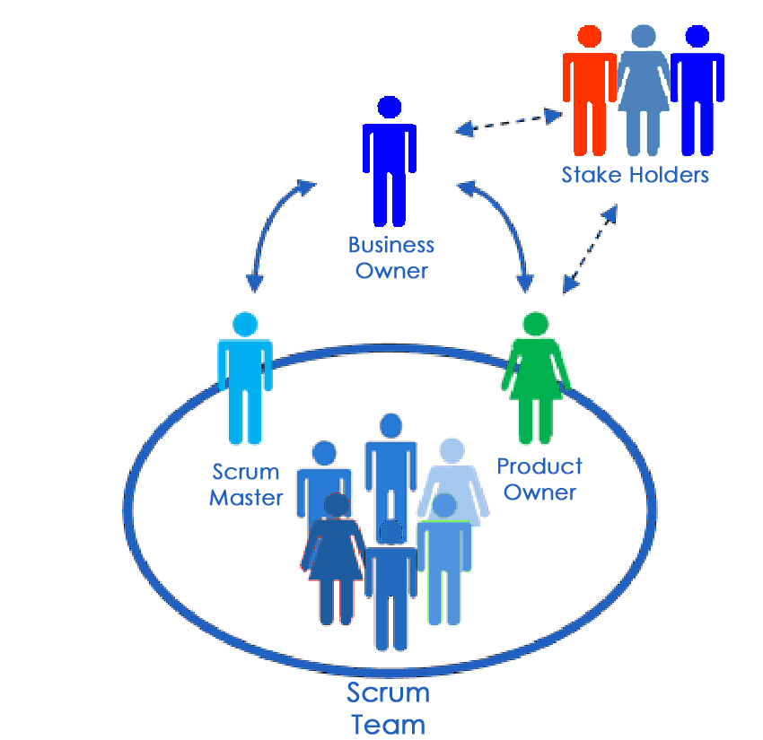

Slide 12
Scrum Events
Sprint-a time-box of one month or less during which a “Done”, useable, and potentially releasable product Increment is created.(Scrum Development Team)
Sprint Planning-the work to be performed in the Sprint is planned at the Sprint Planning. This plan is created by the collaborative work of the entire Scrum Team.(Scrum Master)
Daily Scrum-a 15-minute time-boxed event for the Development Team to synchronize activities and create a plan for the next 24 hours. (Development Team)
Sprint Review-held at the end of the Sprint to inspect the Increment and adapt the Product Backlog if needed.(Scrum Team and key stakeholders, Product Owner)
Sprint Retrospective-an opportunity for the Scrum Team to inspect itself and create a plan for improvements to be enacted during the next Sprint, is at most a three-hour meeting for one-month Sprints. For shorter Sprints, the event is usually shorter. (Scrum Master)

Slide 13
Scrum Artifacts
Product Backlog-ordered list of everything that is known to be needed in the product. It is the single source of requirements for any changes to be made to the product
Sprint Backlog-the set of Product Backlog items selected for the Sprint, plus a plan for delivering the product Increment and realizing the Sprint Goal.
Increment-the sum of all the Product Backlog items completed during a Sprint and the value of the increments of all previous Sprints.

Slide 14
Sources
http://scrummethodology.com/
https://www.scrum.org/resources/what-is-scrum

